Slide 1
Machine Learning and Record Linkage
With thanks to Rayid Ghani, Lise Getoor, Nick Monath and Andrew McCallum

Slide 2
Structure of the day
9:00-9:30 Your ideas on additional fields
9:30-10:30 Lecture
10:30-11:00 Break
11:00-11:30 Bias and Training Data
11:30-12:00 API Data pull
12:00-12:30 Lunch
12:30 – 1:00 Notebook
1:00-2:00 Class work
2-2:30 Report back
2:30 Close

Slide 3
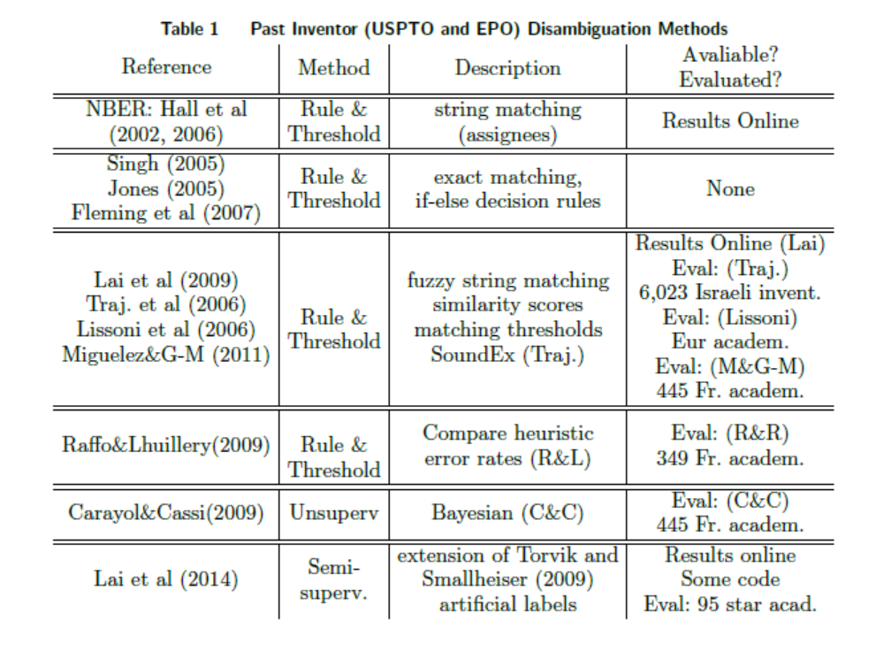

Slide 4
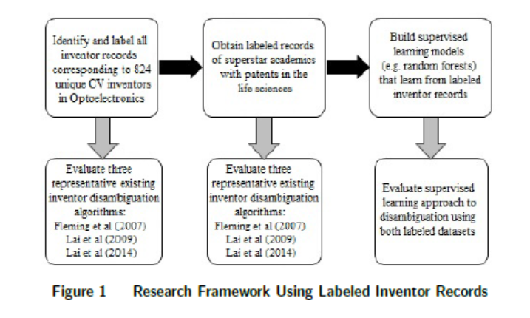

Slide 5
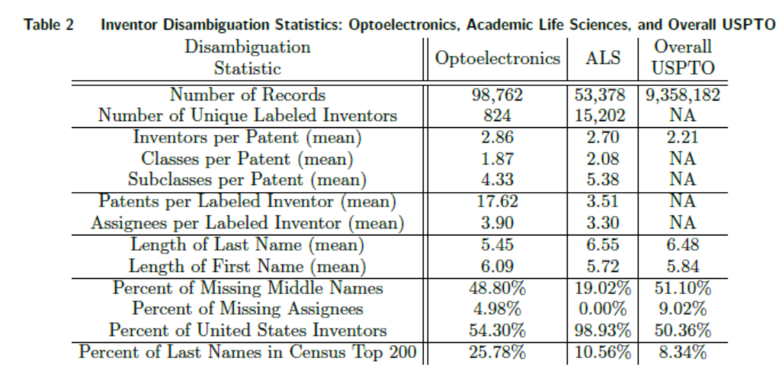

Slide 6
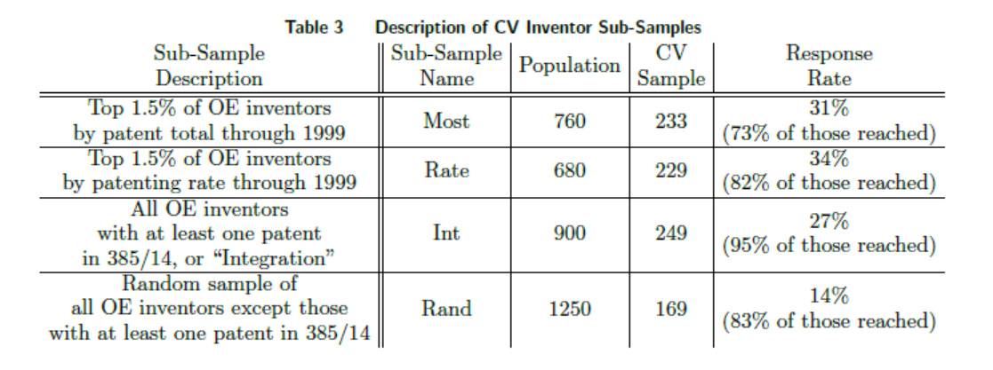

Slide 7
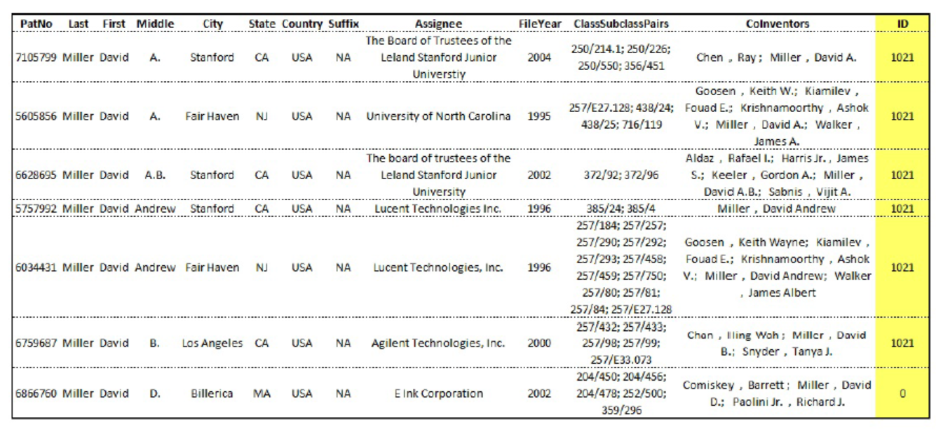

Slide 8
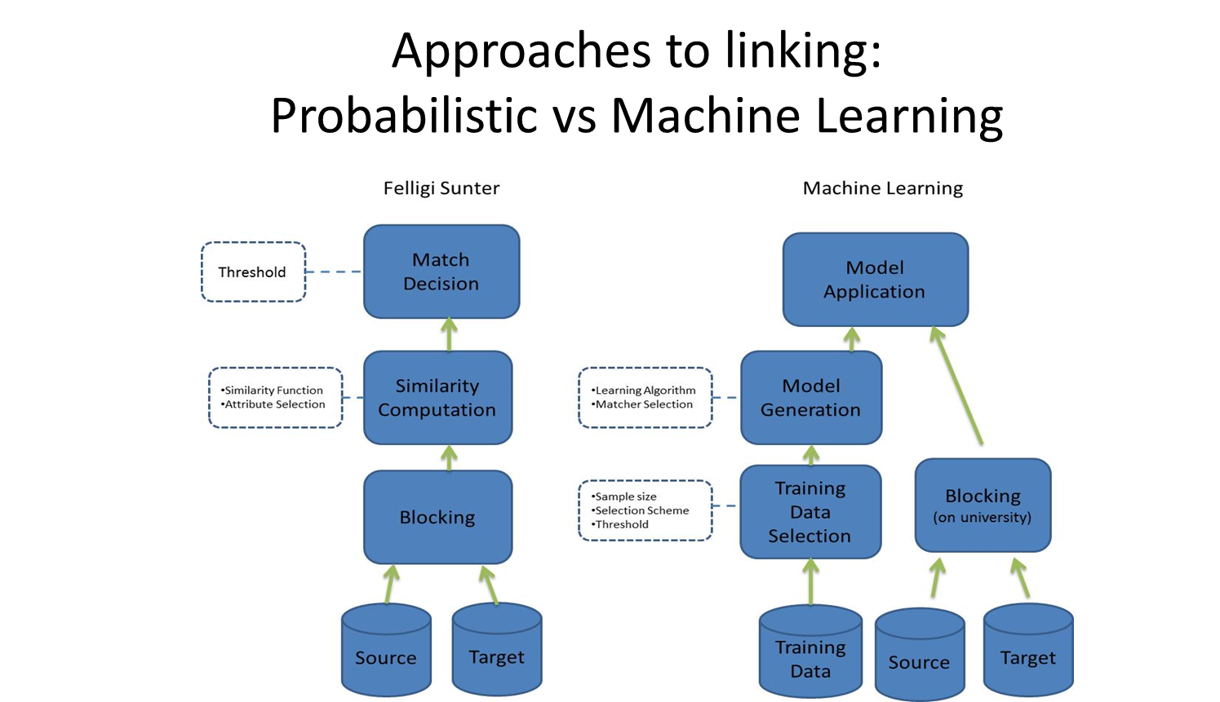

Slide 9
Machine Learning
“A computer program is said to learn from experience E with respect to some task T and some performance measure P, if its performance on T, as measured by P, improves with experience E.”

Slide 10

Notes:
Usps
Amazon/netflix - recommender
Advertising
Health
Autonomous cars

Slide 11
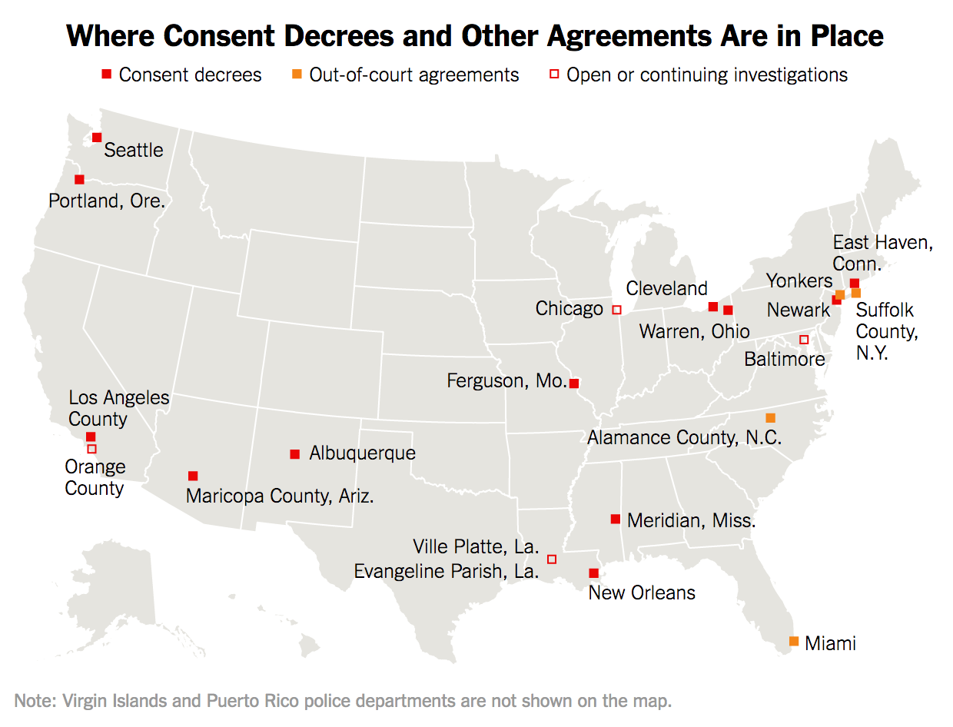
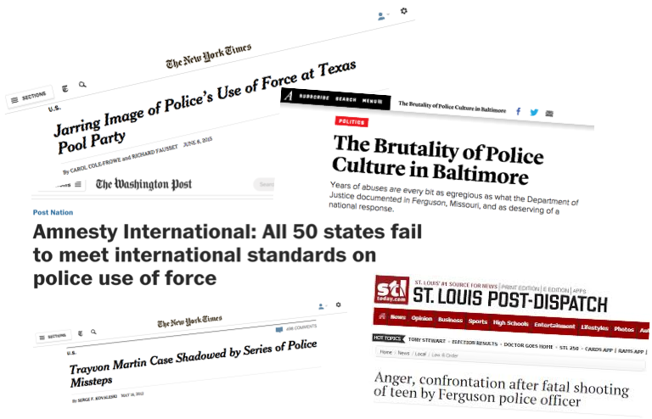
Reducing Adverse Police Incidents (Charlotte Mecklenburg, NC and Nashville, TN)
Identifying Police Officers at Risk of Adverse Events. Carton et al. (KDD 2015)
Early Intervention Systems: Predicting Adverse Interactions Between Police and the Public. Helsby et al. (Criminal Justice Policy Review)

Slide 12



Reducing (Jail) Recidivism through Prioritized Mental Health Outreach (Johnson County, KS)
Reducing Incarceration through Prioritized Interventions. Bauman et. al. ACM COMPASS 2018
11 MILLION
IN THE TOP 200 PREDICTIONS
people move through 3,100 Jails
$22 BILLION
104 individuals went to jail in the next year
in cost
64%
19 years total jail time
suffer from mental illness
68%
Currently Running a 12-month Randomized Controlled Trial to:
1. Evaluate the effectiveness of the interventions on high risk individuals
2. Determine intervention effectiveness based on risk level
have a substance abuse disorder
44%
suffer from chronic health problems

Slide 13
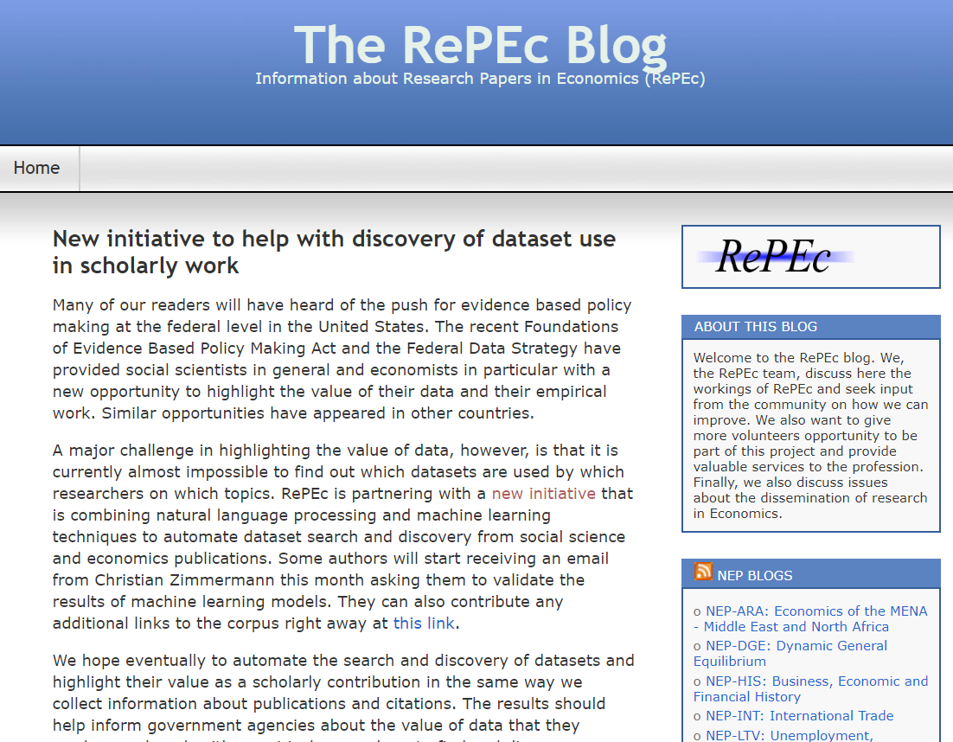
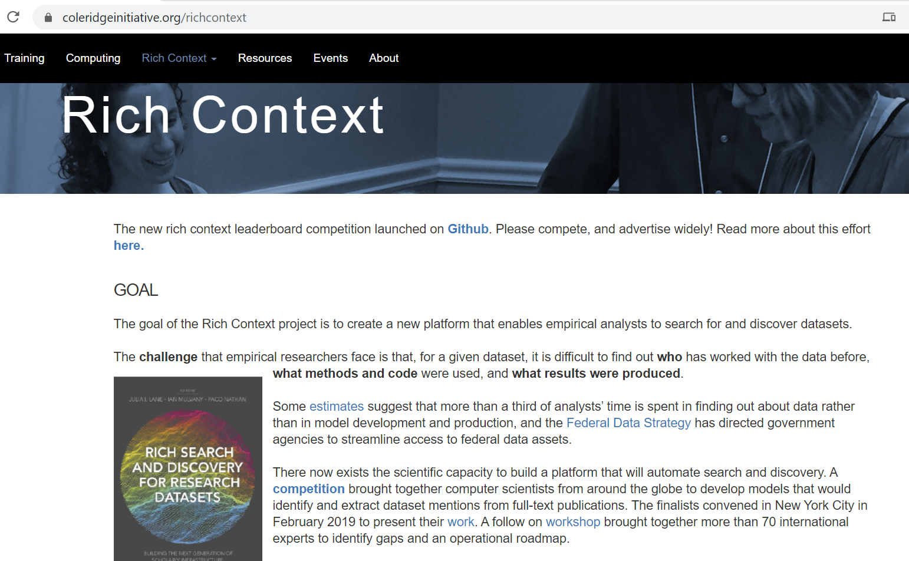
Rich Context

Slide 14
Rich Context Call
1. The leaderboard competition inviting NLP research teams to develop models to automatically detect dataset usage from the text of research publications is now officially launched at https://github.com/Coleridge-Initiative/rclc. Here is an article that describes the re-launched ML competition
2. Open source Python library richcontext-scholapi which provides API integrations for federating discovery services and metadata exchange across multiple scholarly infrastructure providers. Use the library, contribute code, add feature requests and other feedback – they’re identified as issues on the GitHub repo,.
3. A knowledge graph of known links between datasets, research publications, researchers and experts, and projects within the social sciences is in the works. See the open source project in development – This is combined with the API integrations mentioned above to identify metadata errors in popular discovery services.
4. Project Jupyter has created a set of JupyterLab extensions which handle datasets as top-level constructs. New features include the Data Registry, the Metadata Explorer, and Commenting which enable users to register datasets within research projects; browse metadata on their datasets while they work; and comment and collaborate in real-time on shared projects and datasets. The eventual goal is to enrich the knowledge graph with information gleaned from comments, collaboration and computing within the Jupyter environment; and develop a recommendation engine for datasets and code.

Slide 15
Machine Learning Process
Understand policy problem
Map to Machine Learning problem
Get (and integrate) the data
Explore and Process the data
Create “Features” (variables/covariates/predictors/independent variables)
Select methods to try
Evaluate methods
Deploy, Maintain, Update

Slide 16
Types of Learning
Unsupervised
Clustering
PCA
Association Rules
…
Supervised
Classification
Regression
…

Slide 17
Unsupervised Learning
No outcome or dependent variable is present
Goal is exploration, understanding historical data, finding patterns and/or groups in the data
Examples
Clustering (cluster analysis)
Principal Components Analysis
Association Rules (beer and diapers)

Slide 18
Clustering
A good clustering method will produce clusters with
High intra-cluster similarity
Low inter-cluster similarity
K-Means is the simplest and the most common algorithm

Slide 19
K-means example, step 1
k₁
Y
Pick 3
initial
cluster
centers
(randomly)
k₂
k₃
X

Slide 20
K-means example, step 2
k₁
Y
k₂
Assign
each point
to the closest
cluster
center
k₃
X

Slide 21
K-means example, step 3
k₁
k₁
Y
Move
each cluster center
to the mean
of each cluster
k₂
k₃
k₂
k₃
X

Slide 22
K-means example, step 4
Reassign
points
closest to a different new cluster center
k₁
Y
k₃
k₂
X

Slide 23
K-means example, step 4 …
k₁
Y
Reassigned Data points
k₃
k₂
X

Slide 24
K-means example, step 4b
k₁
Y
re-compute cluster means
k₃
k₂
X

Slide 25
K-means example, step 5
k₁
Y
k₂
move cluster centers to cluster means
k₃
X

Slide 26
K-means algorithm
Given k, the k-means algorithm works as follows:
Randomly choose k data points (seeds) to be the initial centroids (cluster centers)
Assign each data point to the closest centroid
Re-compute the centroids using the current cluster memberships.
If a convergence criterion is not met, go to 2).

Slide 27
More Clustering Methods
K-means
Iteratively re-assign points to the nearest cluster center
Agglomerative clustering
Start with each point as its own cluster and iteratively merge the closest clusters
Mean-shift clustering
Estimate modes of pdf
Spectral clustering
Split the nodes in a graph based on assigned links with similarity weights
As we go down this chart, the clustering strategies have more tendency to transitively group points even if they are not nearby in feature space

Slide 28
Exploring and Understanding clusters
Visualizing using PCA
Doing descriptive stats for each cluster
Use decision trees with cluster ids as labels to generate rules describing each cluster

Slide 29
Evaluating Clustering Methods
Objective Evaluation
Task-Specific Evaluation
Same data can be clustered in different ways in different number of clusters

Slide 30
Evaluation
Chicago Cleveland
New York Minneapolis Charlotte
London
Tokyo
Rio de Janeiro
Mexico City

Slide 31
Unsupervised Learning: Recap
Used to understand patterns and groups in data
Interactive (multivariate) data exploration

Slide 32
Supervised learning framework
y
= f( )
X
output
“Learned”
function
Features/Predictors
future/generalization
Training or Learning: Find an f that minimizes error in recovering y

Slide 33
Supervised learning framework
y
= f( )
X
output
“Learned”
function
Features/Predictors
Training: Given a training set of labeled examples {(x₁,y₁), …, (x_{N},y_{N})}, estimate the prediction function f that minimizes future generalization (out of sample) error
Scoring/Testing: apply f to a new example x and output the predicted value y = f(x)

Slide 34
(Some) Popular/Common Methods
Nearest neighbor
Decision Trees
Regression
Support Vector Machines
Bayes Classifier
Neural Networks
Ensembles
Bagging
Boosting
Random Forests
We’ll skip details of these methods for now

Slide 35
How to solve a prediction problem
Define and Create Rows (unit of prediction)
Define and Create Label (outcome variable)
Define and Create Features (predictors)
Create Training and Validation Sets
Train model(s) on Training Set
Validate model(s) on Validation Set
Select “best” model

Slide 36
Validation
You’ve run a large number of different types of models
Now:
You need to understand what types of models work when
and
You need to decide which one(s) to use in the future

Slide 37
What’s required to validate
Validation Methodology
Validation Metric(s)
Comparing to baselines

Slide 38
In-sample
Data
Train
Test

Slide 39
Out-of-Sample
Data
Train
Test

Slide 40
k-fold Cross-Validation
Data
1
2
3
4
5
Train
Test

Slide 41
k-fold Cross-Validation
Data
1
2
3
4
5
Train
Test

Slide 42
k-fold Cross-Validation
Data
1
2
3
4
5
Train
Test

Slide 43
k-fold Cross-Validation
Data
1
2
3
4
5
Train
Test

Slide 44
k-fold Cross-Validation
Data
1
2
3
4
5
Train
Test

Slide 45
Temporal Holdouts
Data
2002 2017
Train
Test
2002 2007 2008
Train
Test
2002 2008 2009
Train
Test
2002 2009 2010

Slide 46
Training - Time splits
Train
Test
2002 2009 2010
Train
We only use this time
to get outcomes
2002 2009

Slide 47
Evaluation - Methodology
In-sample
Out of sample
Multiple Out-of-sample (Hold-out) Splits
Cross Validation
Leave one out (LOO)
k fold
Temporal Holdouts

Slide 48
Modeling & Validation
Training (Building)
Training Labels
Features
Training
Learned model
Training Data
Testing (Validating)
Features
Learned model
Prediction
Test Data

Slide 49
Evaluation - Metrics
Predictions are often scores between 0 and 1
We need to first turn them into 0 or 1 by selecting a threshold
Predicted Outcome
 | Yes | No
Yes | True Positives (TP) | False Negatives (FN)
No | False Positives (FP) | True Negatives (TN)
Actual Outcome

Slide 50
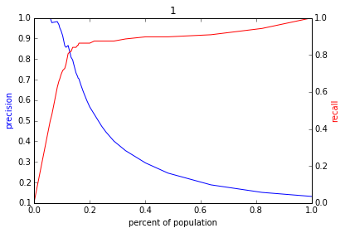
Varying the Threshold
Score
1 .9 .8 .7 .6 .5 .4 .3. .2 .1
| | | | | | | | | |
Baseline

Slide 51
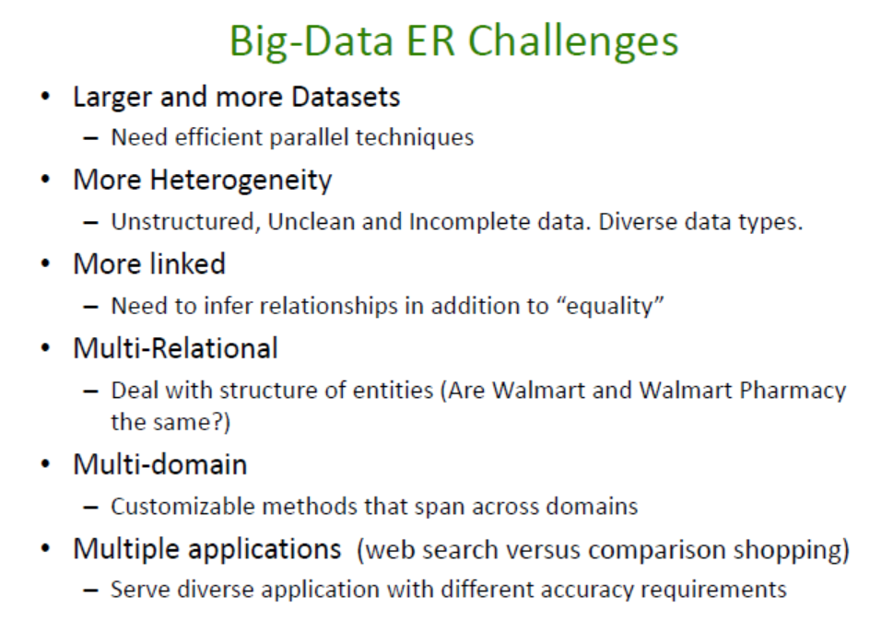
Entity Resolution: Tutorial http://www.cs.umd.edu/~getoor/Tutorials/ER_VLDB2012.pdf

Slide 52
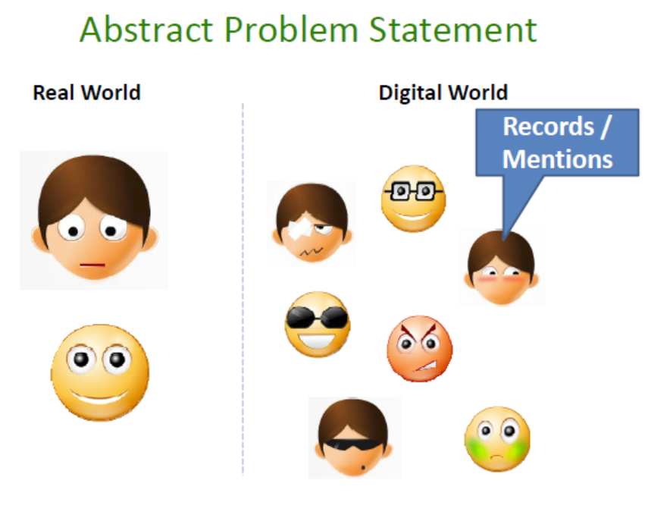

Slide 53
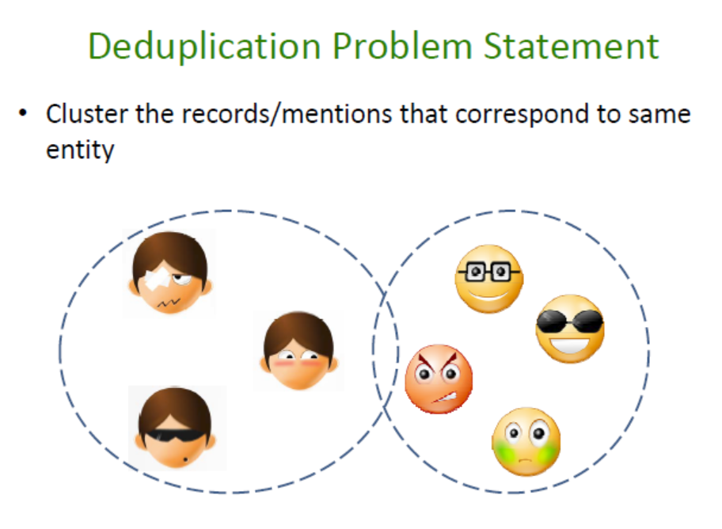

Slide 54
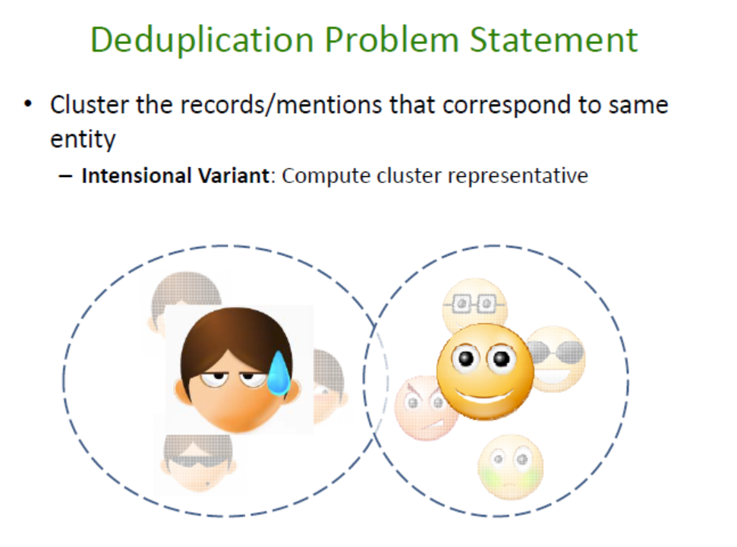

Slide 55
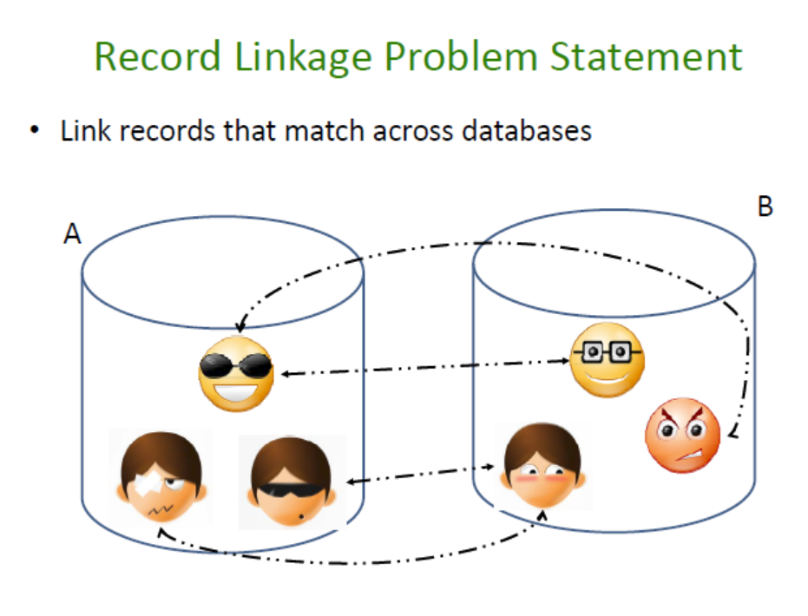

Slide 56
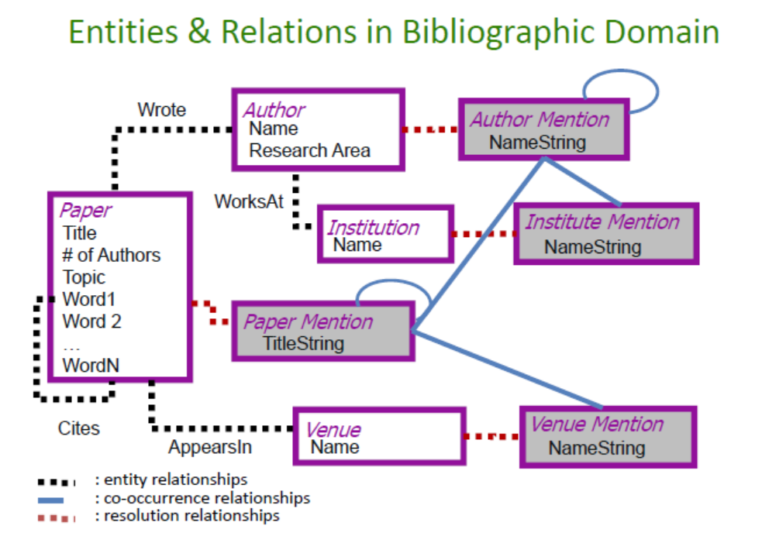

Slide 57
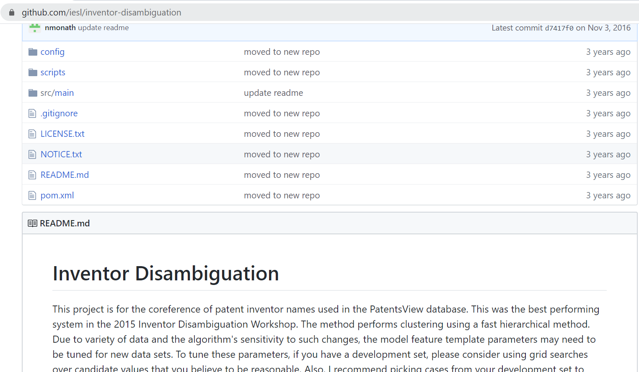
Nicholas Monath and Andrew McCallum. Discriminative Hierarchical Coreference for Inventor Disambiguation. Presentation. PatentsView Inventor Disambiguation Technical Workshop. September 2015 [slides] [code]

Slide 58
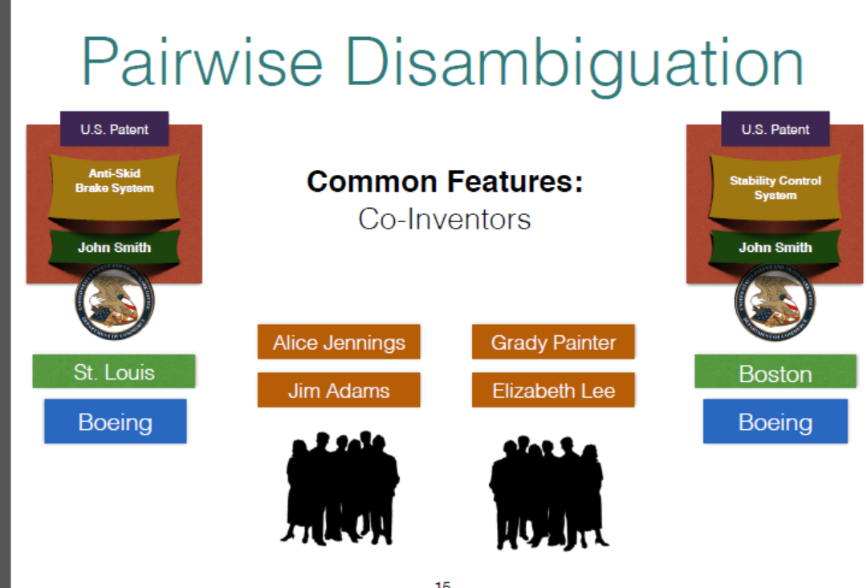

Slide 59
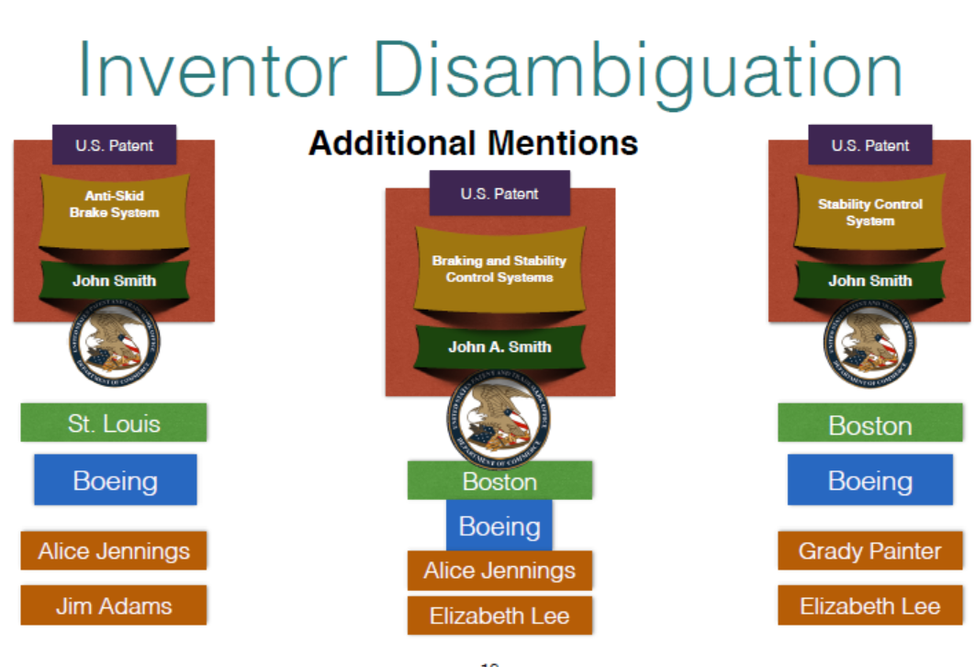

Slide 60
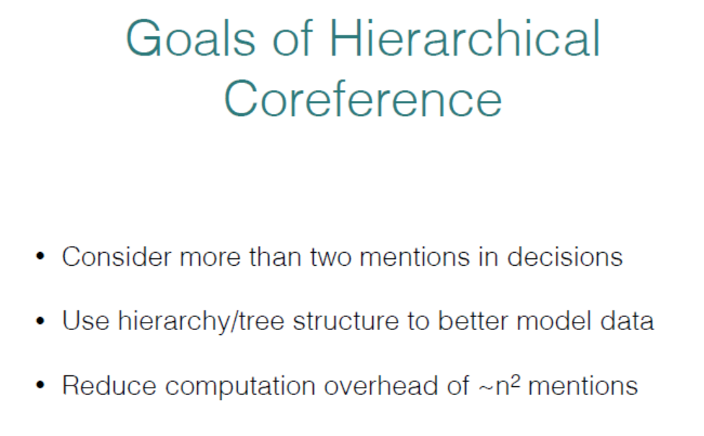

Slide 61
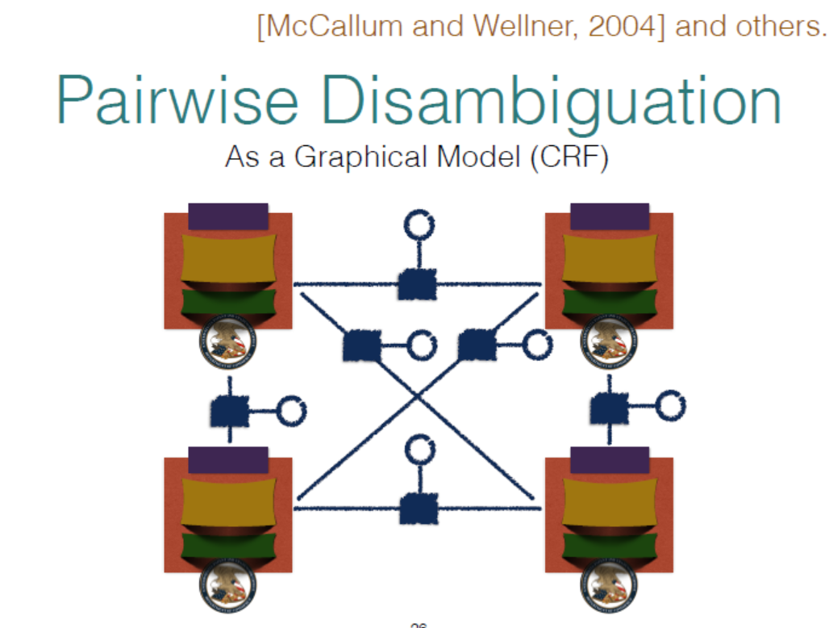

Slide 62
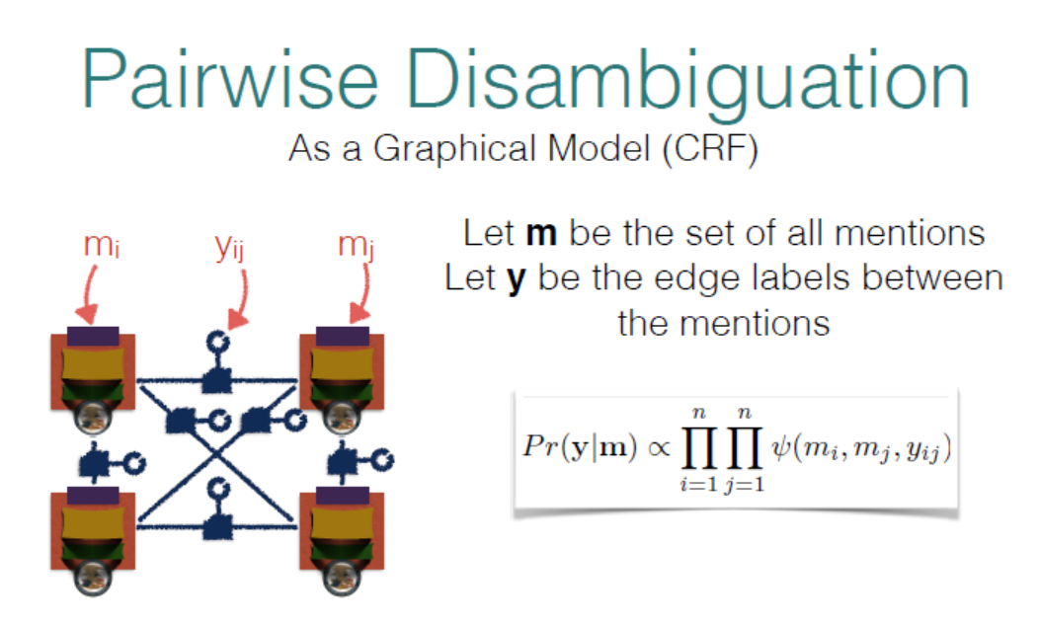

Slide 63
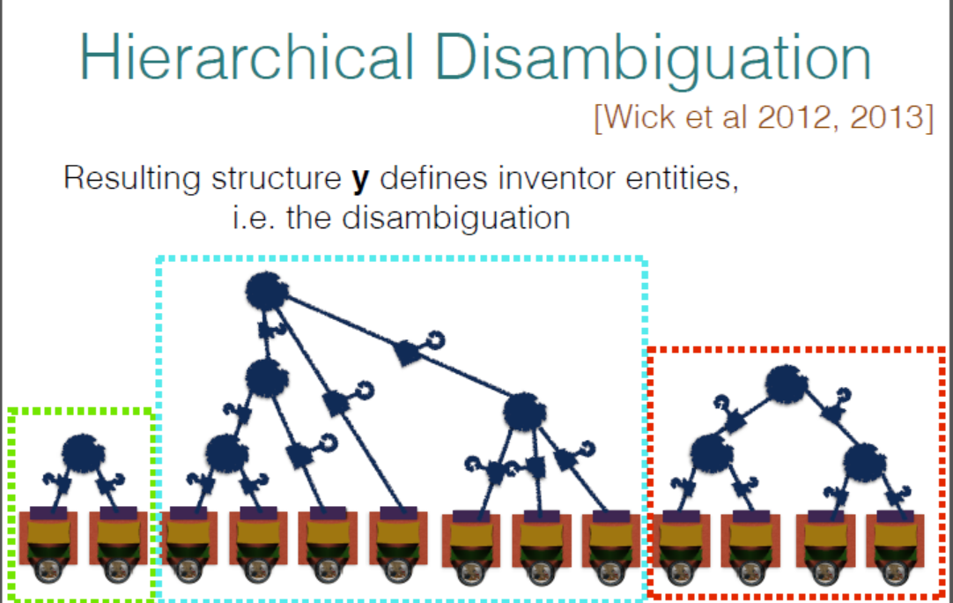

Slide 64
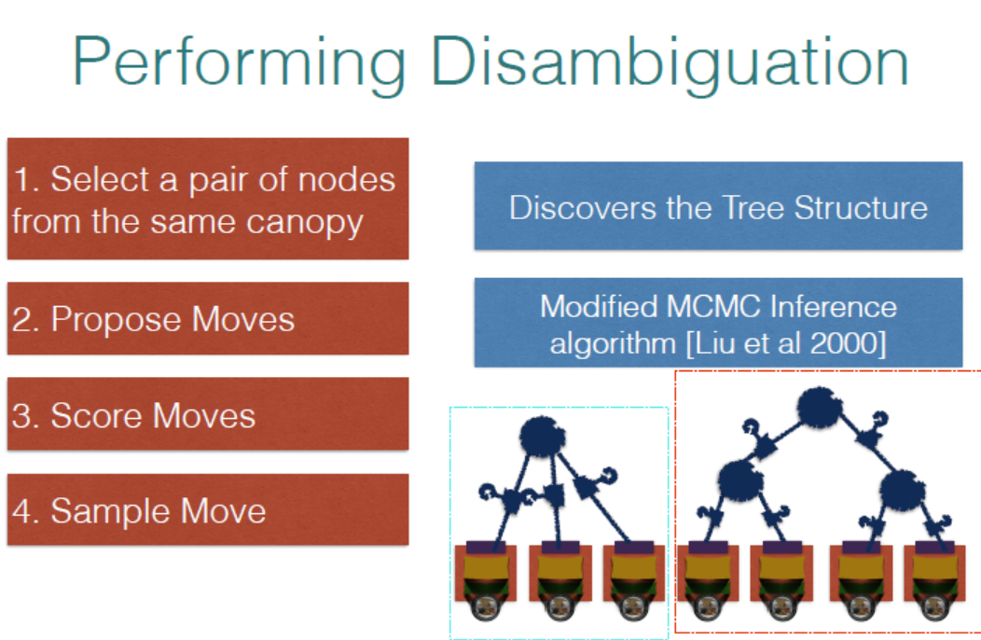

Slide 65
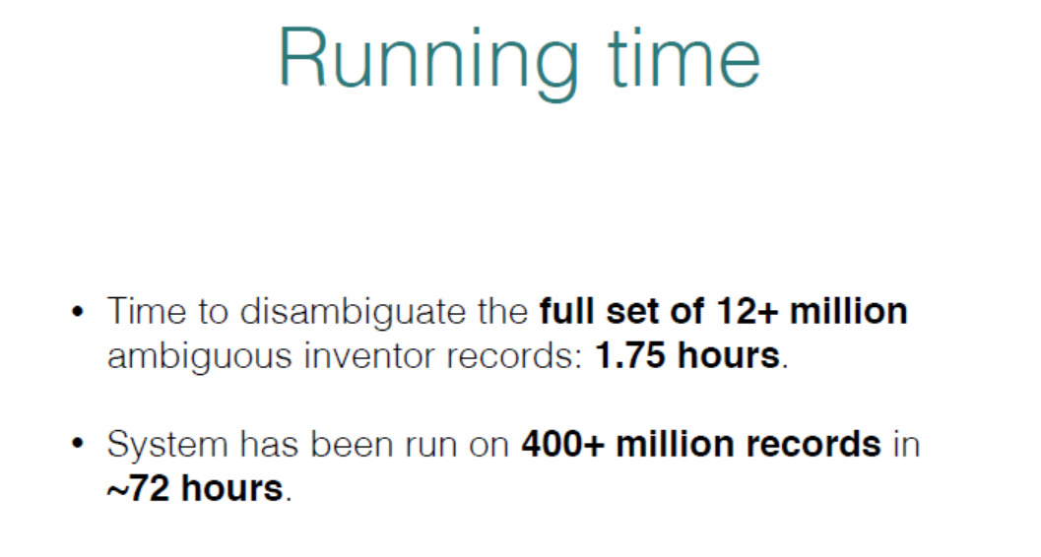

Slide 66
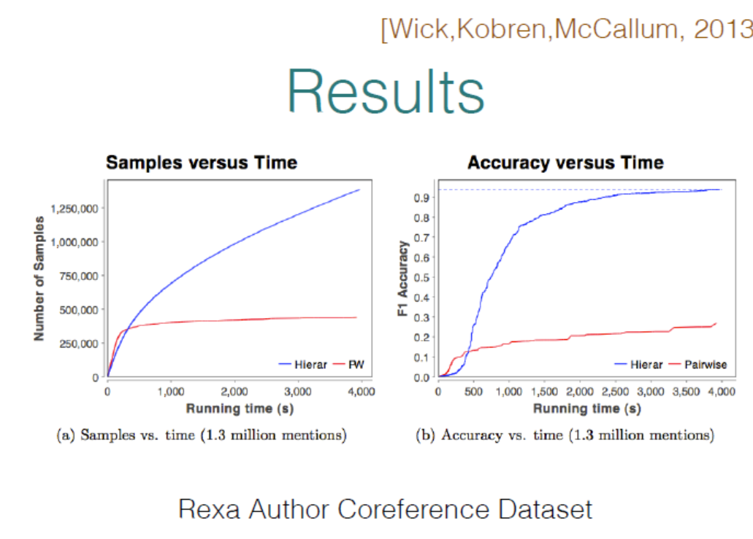

Slide 68
Summary: Record Linkage Technique (Christen 2015)
Deterministic matching
Rule-based matching (complex to build and maintain)
Probabilistic record linkage (Fellegi and Sunter, 1969)
Use available attributes for linking (often personal information, like names, addresses, dates of birth, etc.)
Calculate match weights for attributes
“Computer science” approaches
Based on machine learning, data mining, database, or information retrieval techniques

Slide 69
Summary: Challenges (Christen 2012)
Scalability
Naïve comparison of all record pairs is quadratic
Remove likely no-matches as efficiently as possible
Need efficient etchniques
More linked / multi-relational
Need to infer relationship
No training data in many linkage applications
No record pairs with known true match status

